Slide 1


Wprowadzenie do platformy JAVA 2. JAVA as a programming platform
Hello world!
My name is Duke.
I’m JAVA mascot

Slide 2
Agenda
Java Virtual Machine (JVM)
Java Archive (JAR)
How to use JAR files?
Application Programming Interface (API)
What is it?
How to read JAVA API?
How to create/generate JavaDoc (Java Documentation)?
What is a programing platform?
Java platforms: SE, EE, ME, FX, Card
What is it and why we need many?
How are they different?
Java Standard Edition (Java SE) - introduction
What is JDK (Java Development Kit)?
What does JDK consist of?
Java Enterprise Edition (Java EE) - introduction
What is an enterprise application?
3-tier architecture
What is Jave EE?
Java certification
Exercises

Slide 3
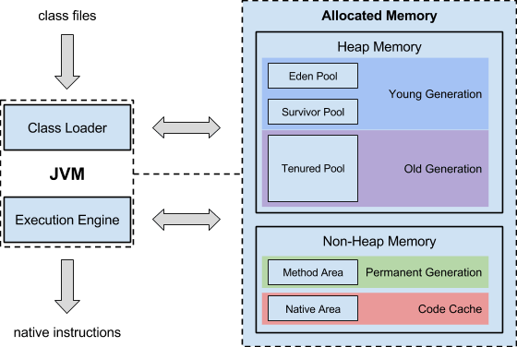
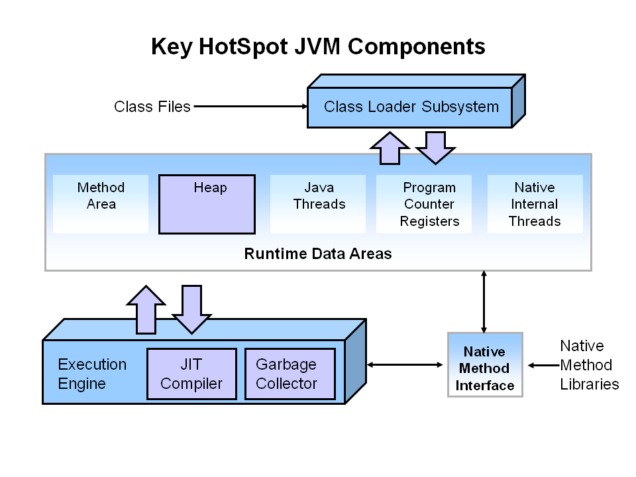
Java Virtual Machine (JVM)
$JAVA_HOME/jre/bin/java
$JAVA_HOME/jre/bin/javaw
$JAVA_HOME/jre/bin/javas
! Class loader principle: load first in class path

Slide 4
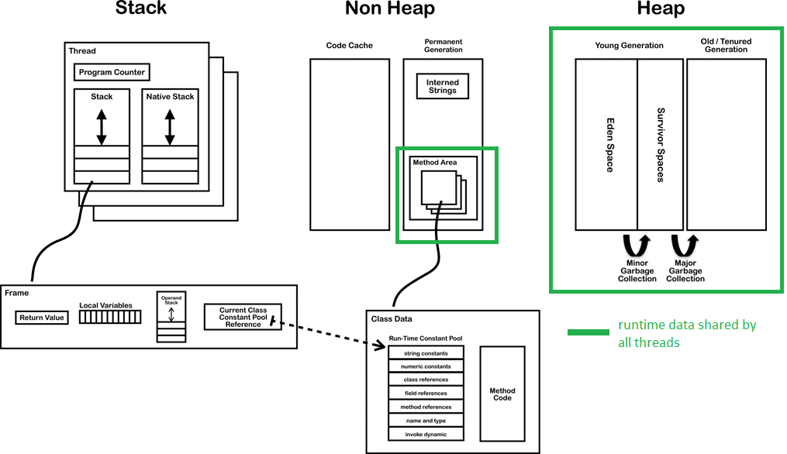
JVM memory

Slide 5

main components of JVM
types/categories of memory present in JVM
difference between thread and process and memory areas they use
Terms: jvm, class loader, thread, process, processor register, garbage collector, process heap, thread stack, native method, JIT (just in-time)

Slide 6


Java ARchive (JAR)
Files (.class, pics, xml, xhtml, etc.)
META-INF directory (metadata files)
ZIP (optional compression)
JAR
Jar tool: $JAVA_HOME/bin/jar
Usage: jar {ctxui}[vfmn0PMe] [jar-file] [manifest-file] [entry-point] [-C dir] files ...
c = create, x = extract, v = verbose, f – output to file (by default STDOUT), e – entry point
Example: jar -cf myJar.jar Hello.class
User documentation: http://docs.oracle.com/javase/tutorial/deployment/jar/
Specification: http://docs.oracle.com/javase/8/docs/technotes/guides/jar/jar.html

Slide 7
Executable JAR
Add to manifest file key-value: Main-Class: <package>.<class name>
Executable
javac -d . Hello.java
jar -cfe App.jar com.test.Hello com
java -jar App.jar
Not executable
jar -cf AppNotExe.jar com
java -cp AppNotExe.jar com.test.Hello

Slide 8

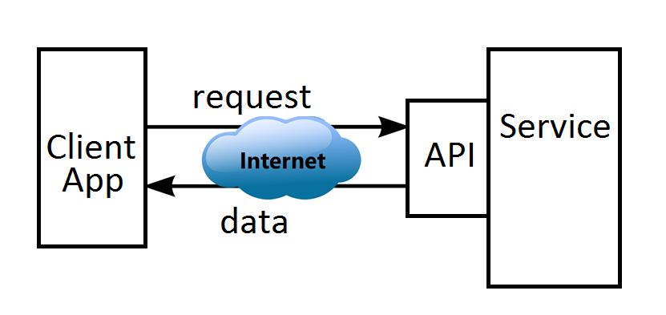
Application Programming Interface (API)

Slide 9
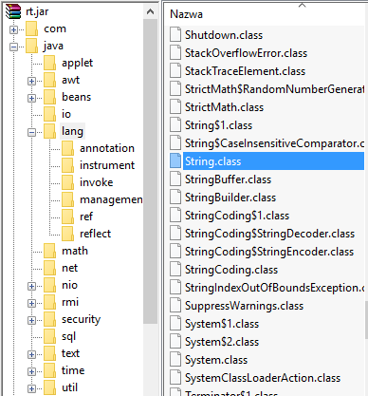
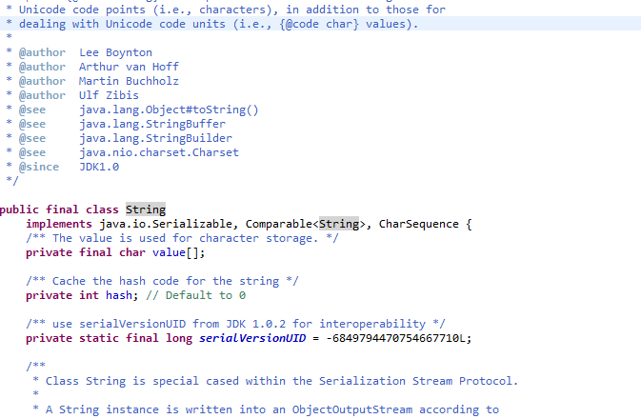
Application Programming Interface (API)
$JAVA_HOME/jre/lib/rt.jar

Slide 10
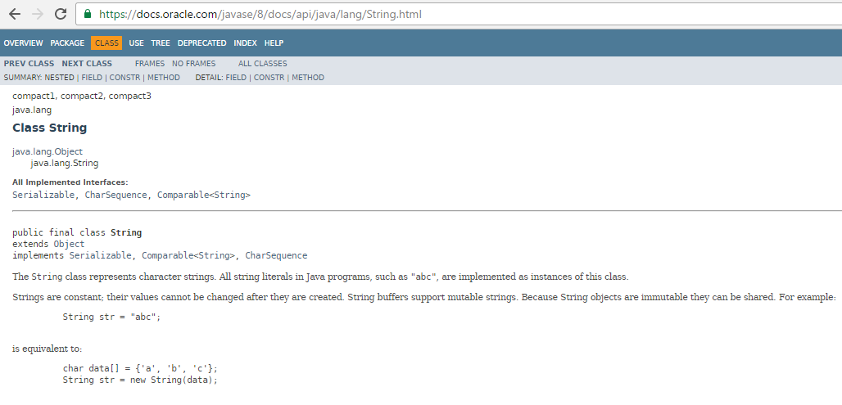

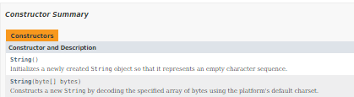


Slide 11
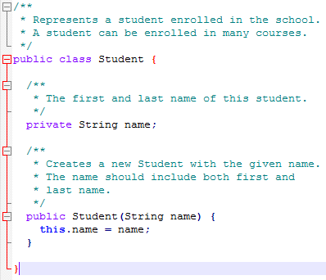
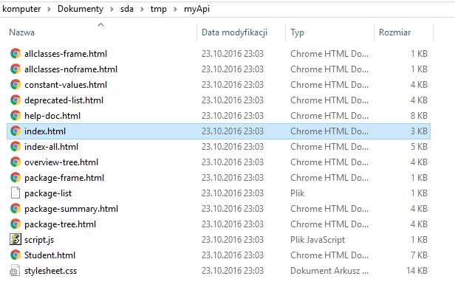
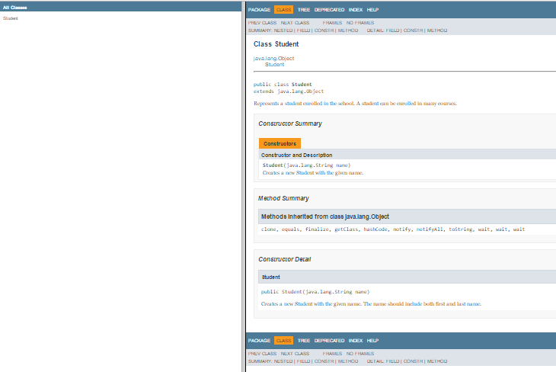
JavaDoc(umentation)
$JAVA_HOME/bin/javadoc
Javadoc –d myApi Student.java
d - destination

Slide 12
Java class files packaging
purpose of manifest file
concept of API
purpose of javadoc tool
basic options for jar tool
basic structure of page in Java API
Terms: jar, api, spec, manifest, meta-inf, annotation, executable jar, Javadoc, key-value data

Slide 13
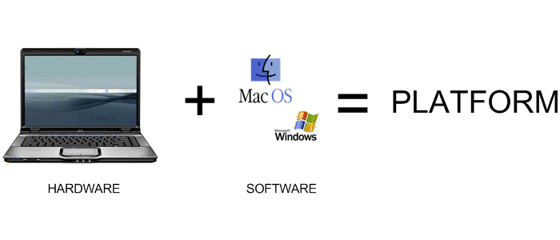
Programing platform
Language specification
Compliant compiler/interpreter + (optional) virtual machine + additional tools, e.g. for monitoring, debugging, documentation
Standard (built-in) libraries + their interface (description how to use them)
Conventions/standards/architecture (documented and described in details):
Naming convention
Versioning
Application architecture
Code distribution and deployment
Communication protocols
Transaction management,
Security, etc.
Software components that are fully compliant with above and reusable / easily pluggable into your software

Slide 14
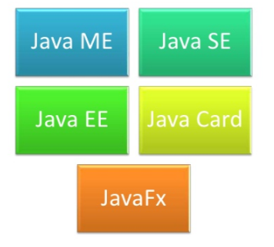
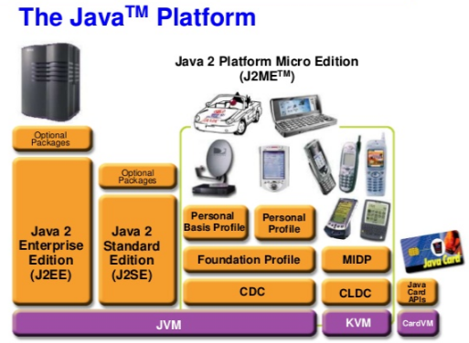
JAVA platforms
SE - Standard Edition – desktop applications
EE - Enterprise Edition – complex, distributed, enterprise applications
ME - Micro Edition – mobile phones and devices with limited resources
FX - Flash and fleX – desktop GUI and rich internet applications (RIA)
Card – embedded (hardware) applications

Slide 15
what JAVA programing platforms we have
their purpose
Terms: EE, SE, ME, platform, programing platform, interface, bug, debugging, tool, transaction, protocol, distributed system

Slide 16

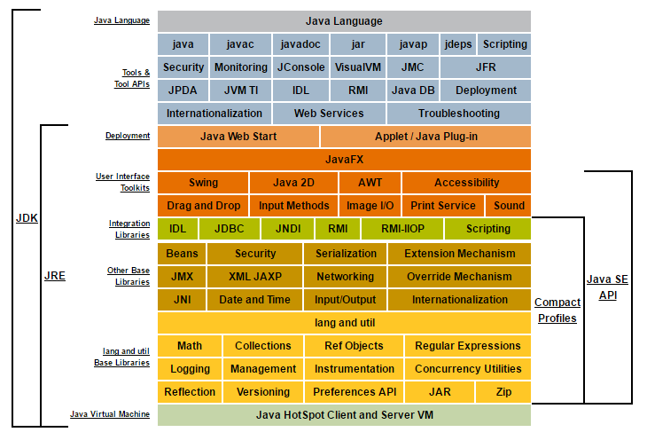
Java SE ~ JDK
JRE (Java Runtime Environment):
-> Mandatory to execute java byte code
JDK (Java Development Kit):
-> Mandatory to develop applications
http://docs.oracle.com/javase/8/docs/technotes/guides/desc_jdk_structure.html

Slide 17
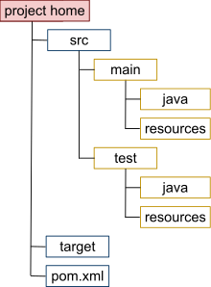
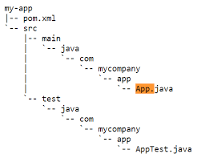
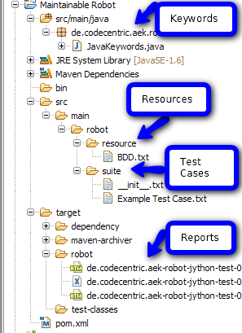
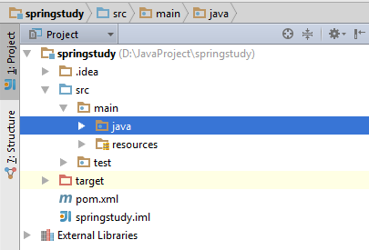
Java SE – Maven project structure
Integrated development environment (IDE):
eclipse
https://linux.die.net/man/1/tree
Linux: tree --help
Windows: tree /?
IntelliJ IDEA

Slide 18
Enterprise application
Large – users/devs/machines/components/processors count
Business oriented – meets business requirements (responsive to business needs)
Mission critical – must sustain continuous operation
maintainable
scalable
parallel processing
network distributed resources
backup/mirroring
monitoring
based on specific architecture (structure of system)

Slide 19
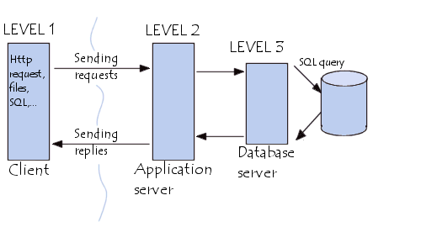
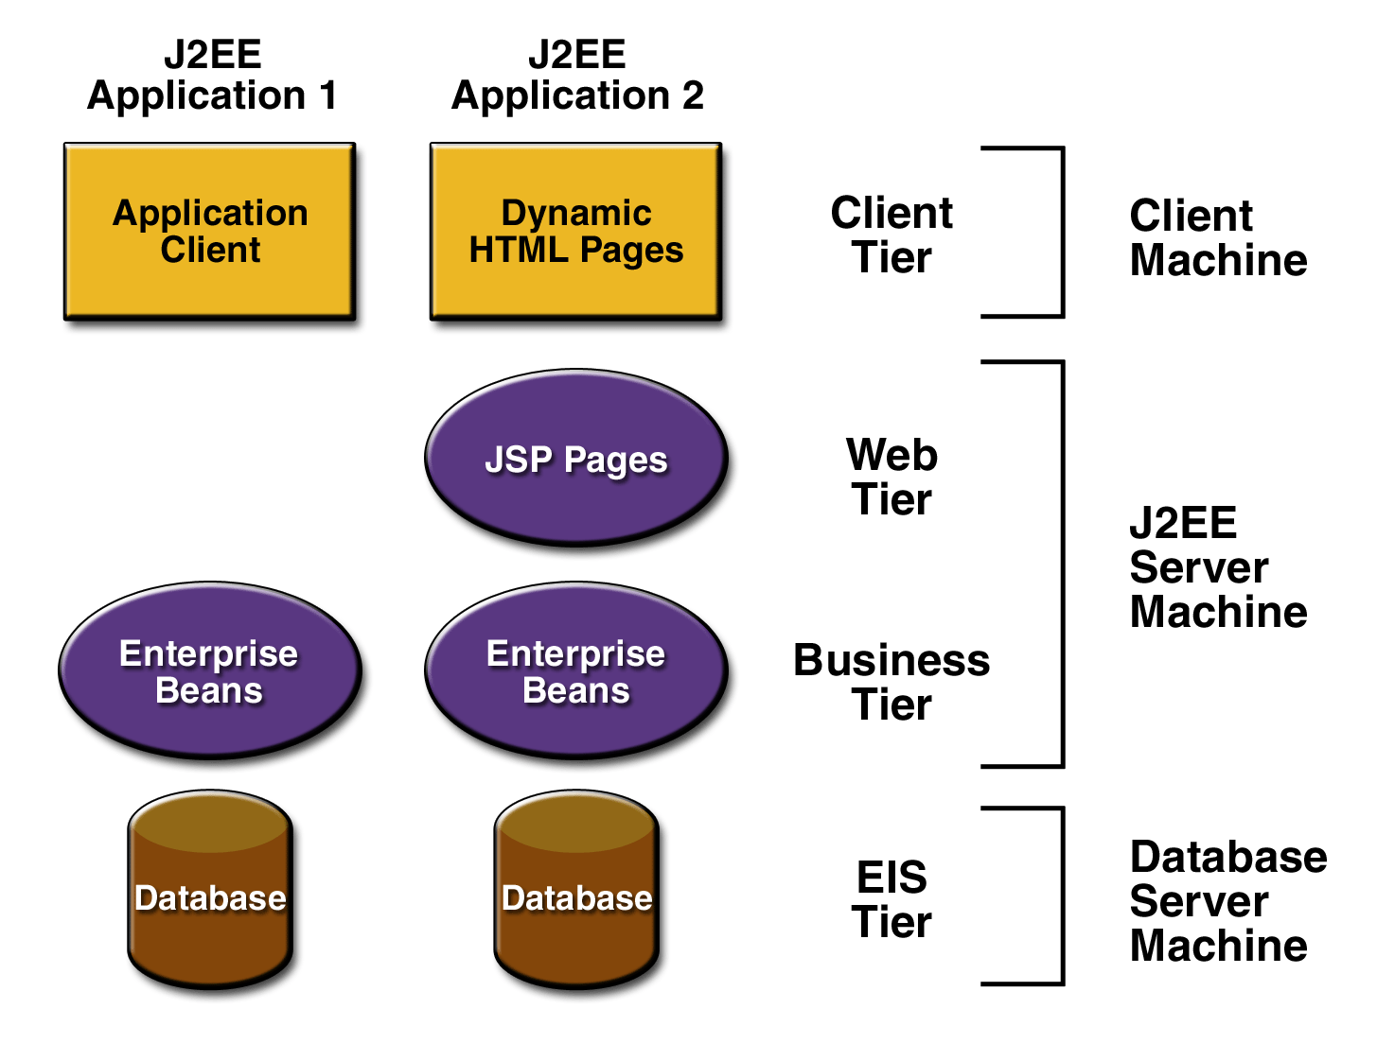
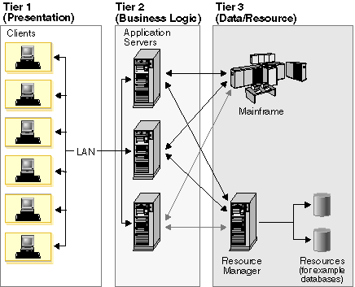
Client-Server 3/multi-tier architecture

Slide 20
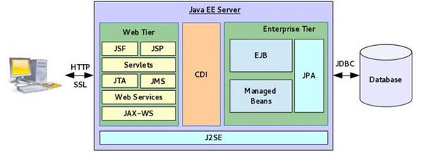
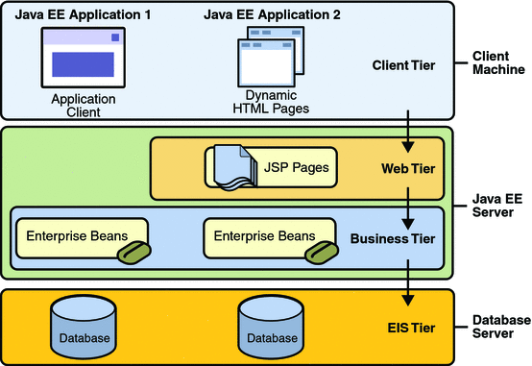
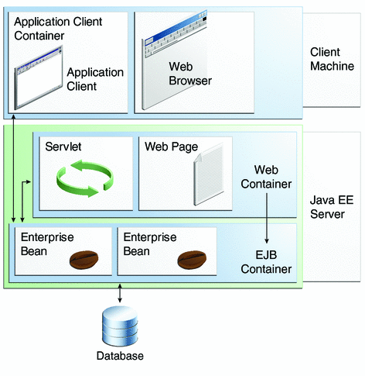
Java EE ~ JDK + architecture + framework based on spec

Slide 21
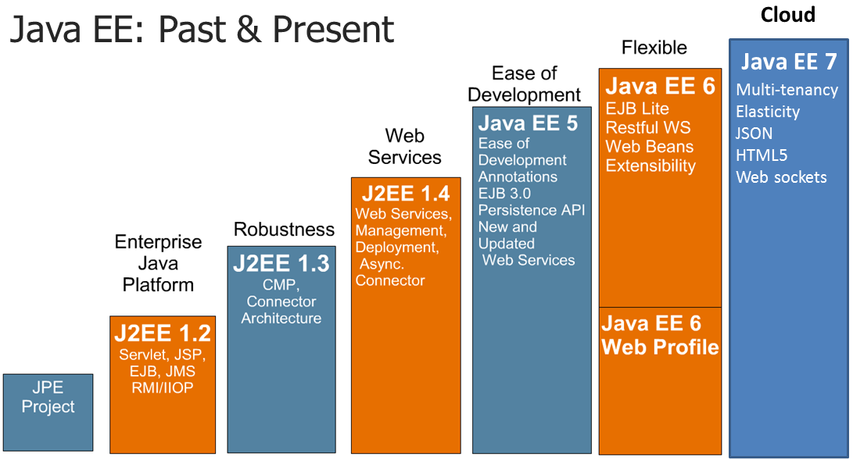

Slide 22
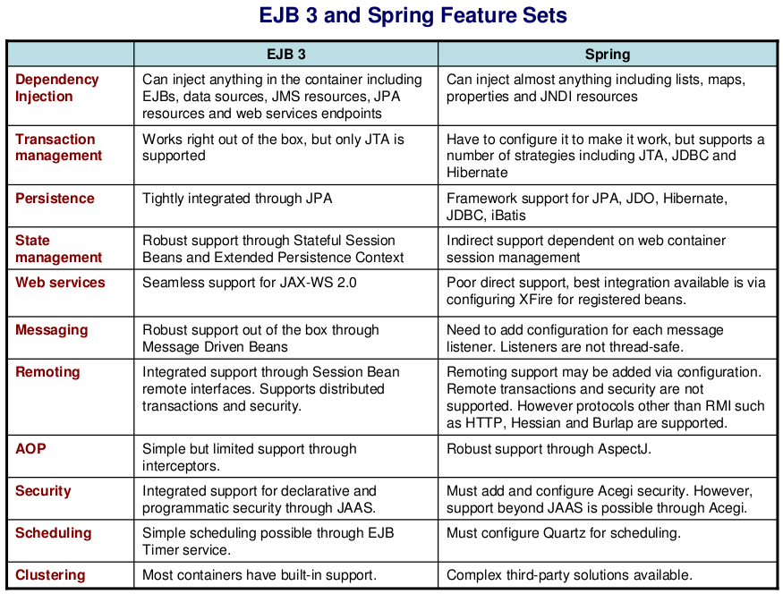
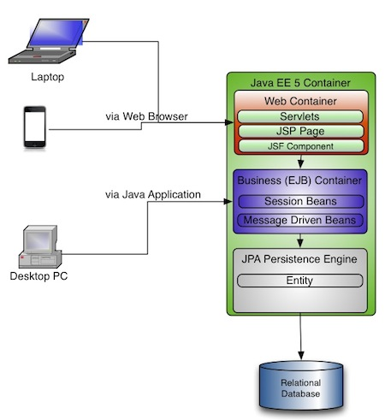
Application framework

Slide 23
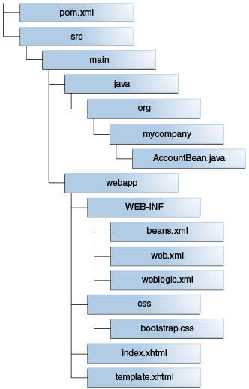
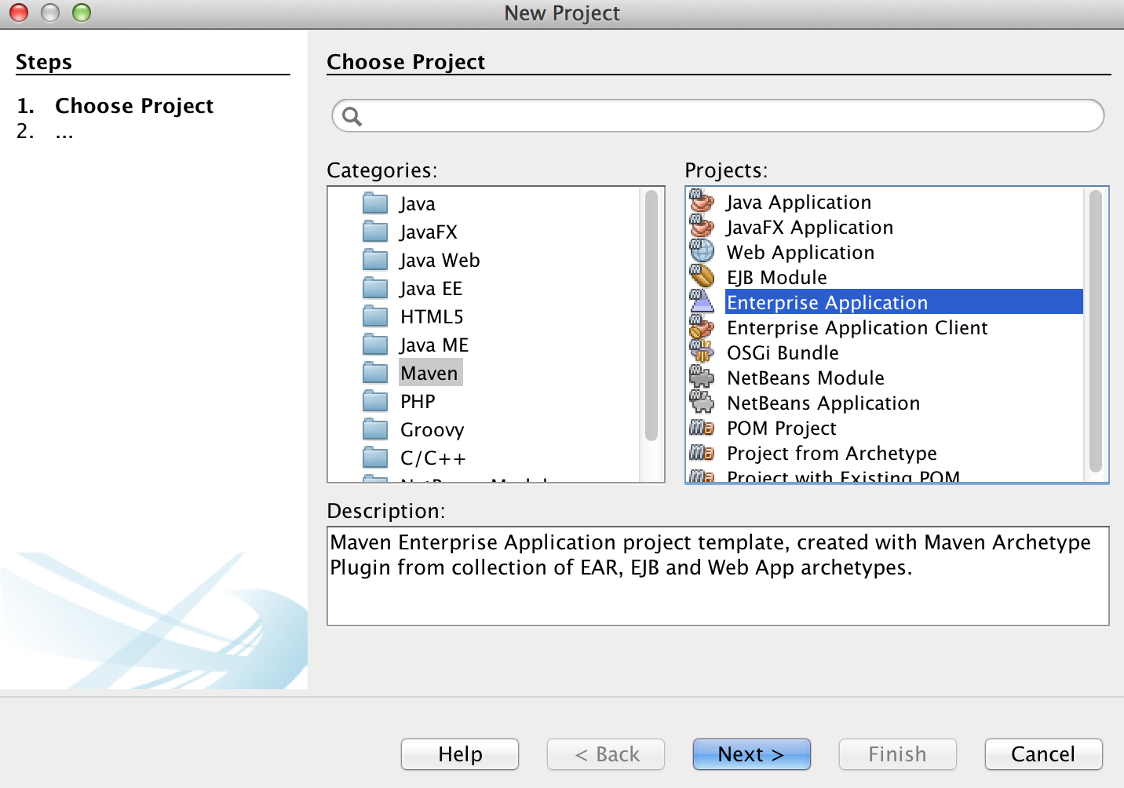
Java EE – Maven project structure
$ mvn archetype:generate
-DgroupId={project-packaging}
-DartifactId={project-name}
-DarchetypeArtifactId=maven-archetype-webapp
-DinteractiveMode=false

Slide 24
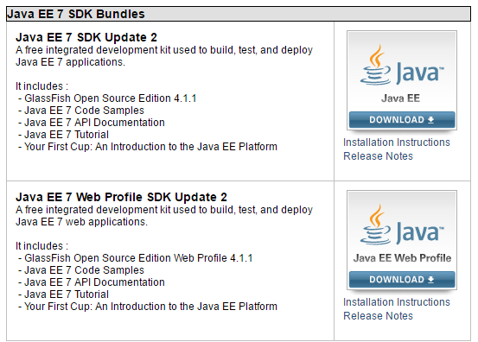
Java EE – Standard Development Kit (SDK)

Slide 25
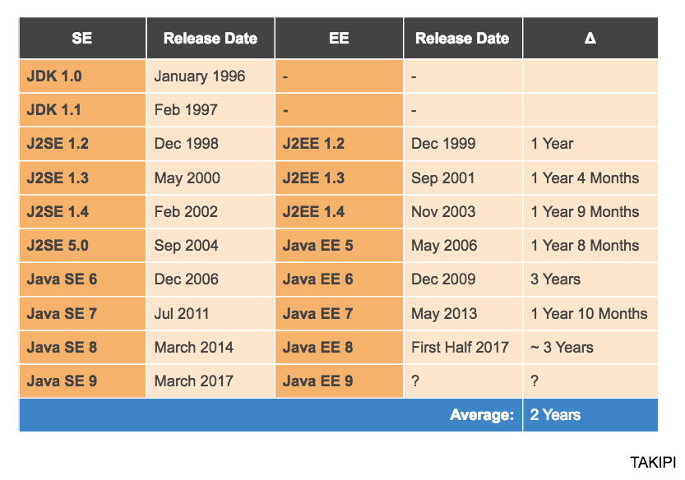

Slide 26
Difference between Java SE and Java EE
Difference between JRE and JDK
Components of JRE and JDK
3-tier architecture
Java EE components
Terms: JRE, JDK, SE, EE, framework, web-container, servlet, EJB (bean), component, software architecture, scalable system, backup

Slide 27
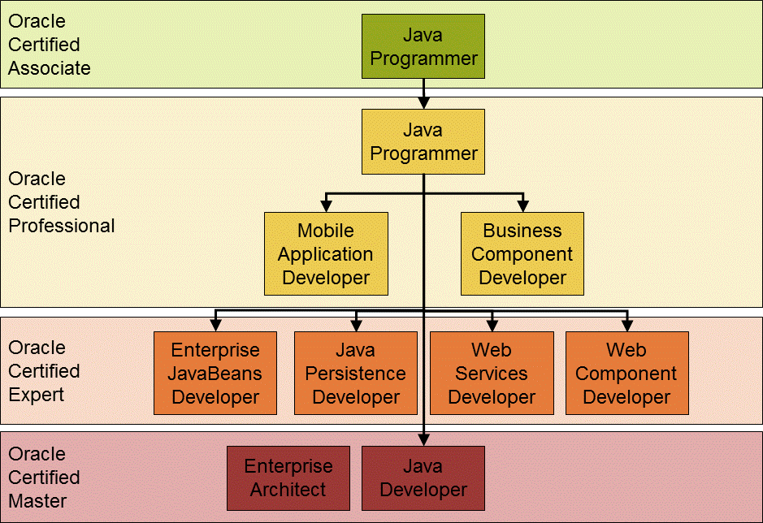
Many APIs, libraries, frameworks, standards, specifications …
https://docs.oracle.com/javase/tutorial/extra/certification/javase-7-programmer1.html

Slide 28
Exercise 1 – jar, javadoc, arithmetic, exceptions, primitive data types
Write an executable jar that will implement simple calculator with operations #, @, $ defined as below:
a # b = M + (a+b)*(2a-b)
a @ b = (a#b)^2 + sqrt(a^3) / abs(b) + cos(b) * Φ - M
a $ b = M * (a#b) – M * (a@b)
where: a – number of type int, b – number of type double, Φ (phi) - constant equal to 1.618033988749895, M (scale factor) – number of type short.
Note: Variables a, b and M (optional, default value = 1) should be passed to program as command line arguments
Annotate class, methods, constants, constructors, class fields
Generate API for your calculator

Slide 29
Exercise 2 – arrays, bit op., STDIN/STDOUT
Based on http://docs.oracle.com/javase/tutorial/index.html
Generate array of length specified by user (STDIN) containing random integer numbers.
If index of element is divisible by 3, then replace this element with:
value * 2^index_of_element
Every 10th element of array should be incremented.
Every 3rd element should be divided by -3.
Calculate sum of all elements that: -20 < value < 20.
Print out result on STDOUT.

Slide 30
Exercise 3 – array, String, loop, optimization
Write a program that will answer if a given number is a palindrome. Examples of palindrome: 1221, 134431, 9985899
Write an automata that will answer if a given word has been generated by given grammar:
S -> abAS | aa
A -> cAd | Ɛ
3. Write a program that will fill 2D array with sequence of natural numbers in whirlpool-like way.
Write a program that will answer if given string is a substring of another string.
Write a program that will find first 1000 primary numbers.

Slide 31
Exercise 4 – comparable, graph, traversal, Map, Date
Implement insertion-sort algorithm that will work for objects of type Person(String name, int age). Sort by name asc, age desc
Write a program that will build bi-directional binary tree using pointers/references and Node structure. (1st level: 1, 2nd: 2,3,4,5, etc.) up to 4th level. Implement also pre-, in-, post-order traversal displaying tree nodes.
Write a program that will count occurrences of words in a given text.
Write a program that for given date-time will return the same date-time in 3 different time zones expressed in ISO standard. Store result in properties file where key is time-zone code and value is calculated date-time.

Slide 32
Exercise 5 – Reflexion, polimorhism, enum, grouping by key (hashCode, equals), interface
Write a program that creates an object of class which name has been passed to program by user. Object should be one of: Cat, Dog, Duck. All classes should implement the same interface Animal { void voice() }; voice – should imitate proper sound (print)
Trade (identified by id and source) is a sequence of monetary transfers called postings. Postings are generated by company (identified by code) that operates in one country. Each posting has:
amount expressed in local and transaction currency,
account on which it has been booked,
functional area code (one of: A, B, C, D)
For given exchange rate table (any currency -> USD) calculate amount in TC.
Group postings by trade, functional area code and local currency. For each group calculate sum of amount in LC.

Slide 33
Exercise 6 – Loops, if, recursion, wrapper class, Collections, Maps
Write a program that will calculate n-th element of Fibbonaci sequence defined as follows:
f(0) = 0, f(1) = 1, f(n+2) = f(n+1) + f(n)
Use recursion
Use recursion + dynamic programing technique
Change recursion to iterative algorithm
Write a program that will find in an ArrayList:
min value
index of element with min value
arithmetic average (avg)
middle element (1- in sense of value, 2 – in sense of index)
number of unique values
index of element which value > sum of all previous (in sense of index) values
cardinality map (value -> number of occurrences of this value)

Slide 34
Exercise 7 – Stack, PriorityQueue, LinkedList, ellipse, Regexp
Write a program that will transform arithmetic expression containing symbols: a, b, +, -, (, ) into Reverse Polish Notation (RPN). Use Stack.
Write a program that will return list of 5 greatest elements in a collection of BigDecimals. Use PriorityQueue.
Write a program that will concatenate n Lists containing String objects. Use ellipse to define formal argument for method.
Write a program that will filter from List containing Strings only these elements that match any of bellow patterns:
starts from “S” or “s”; next contains max 10 digits
contains only small letters from a-d or g-z
starts from “d” and ends with “r” or contains at lest 5 letters “D”
Write a program that in a given text will replace all multi-spaces with single-space.

